Slide 1
TO-DO List Application
BY
Vadde Manjunatha
Likhith N GOwda

Slide 2
Problem Statement
To Create, edit, and delete to-do list items
Mark to-do list items as complete
View a list of all to-do list items, or only incomplete items
Filter to-do list items by category
Sort to-do list items by due date or priority

Slide 3
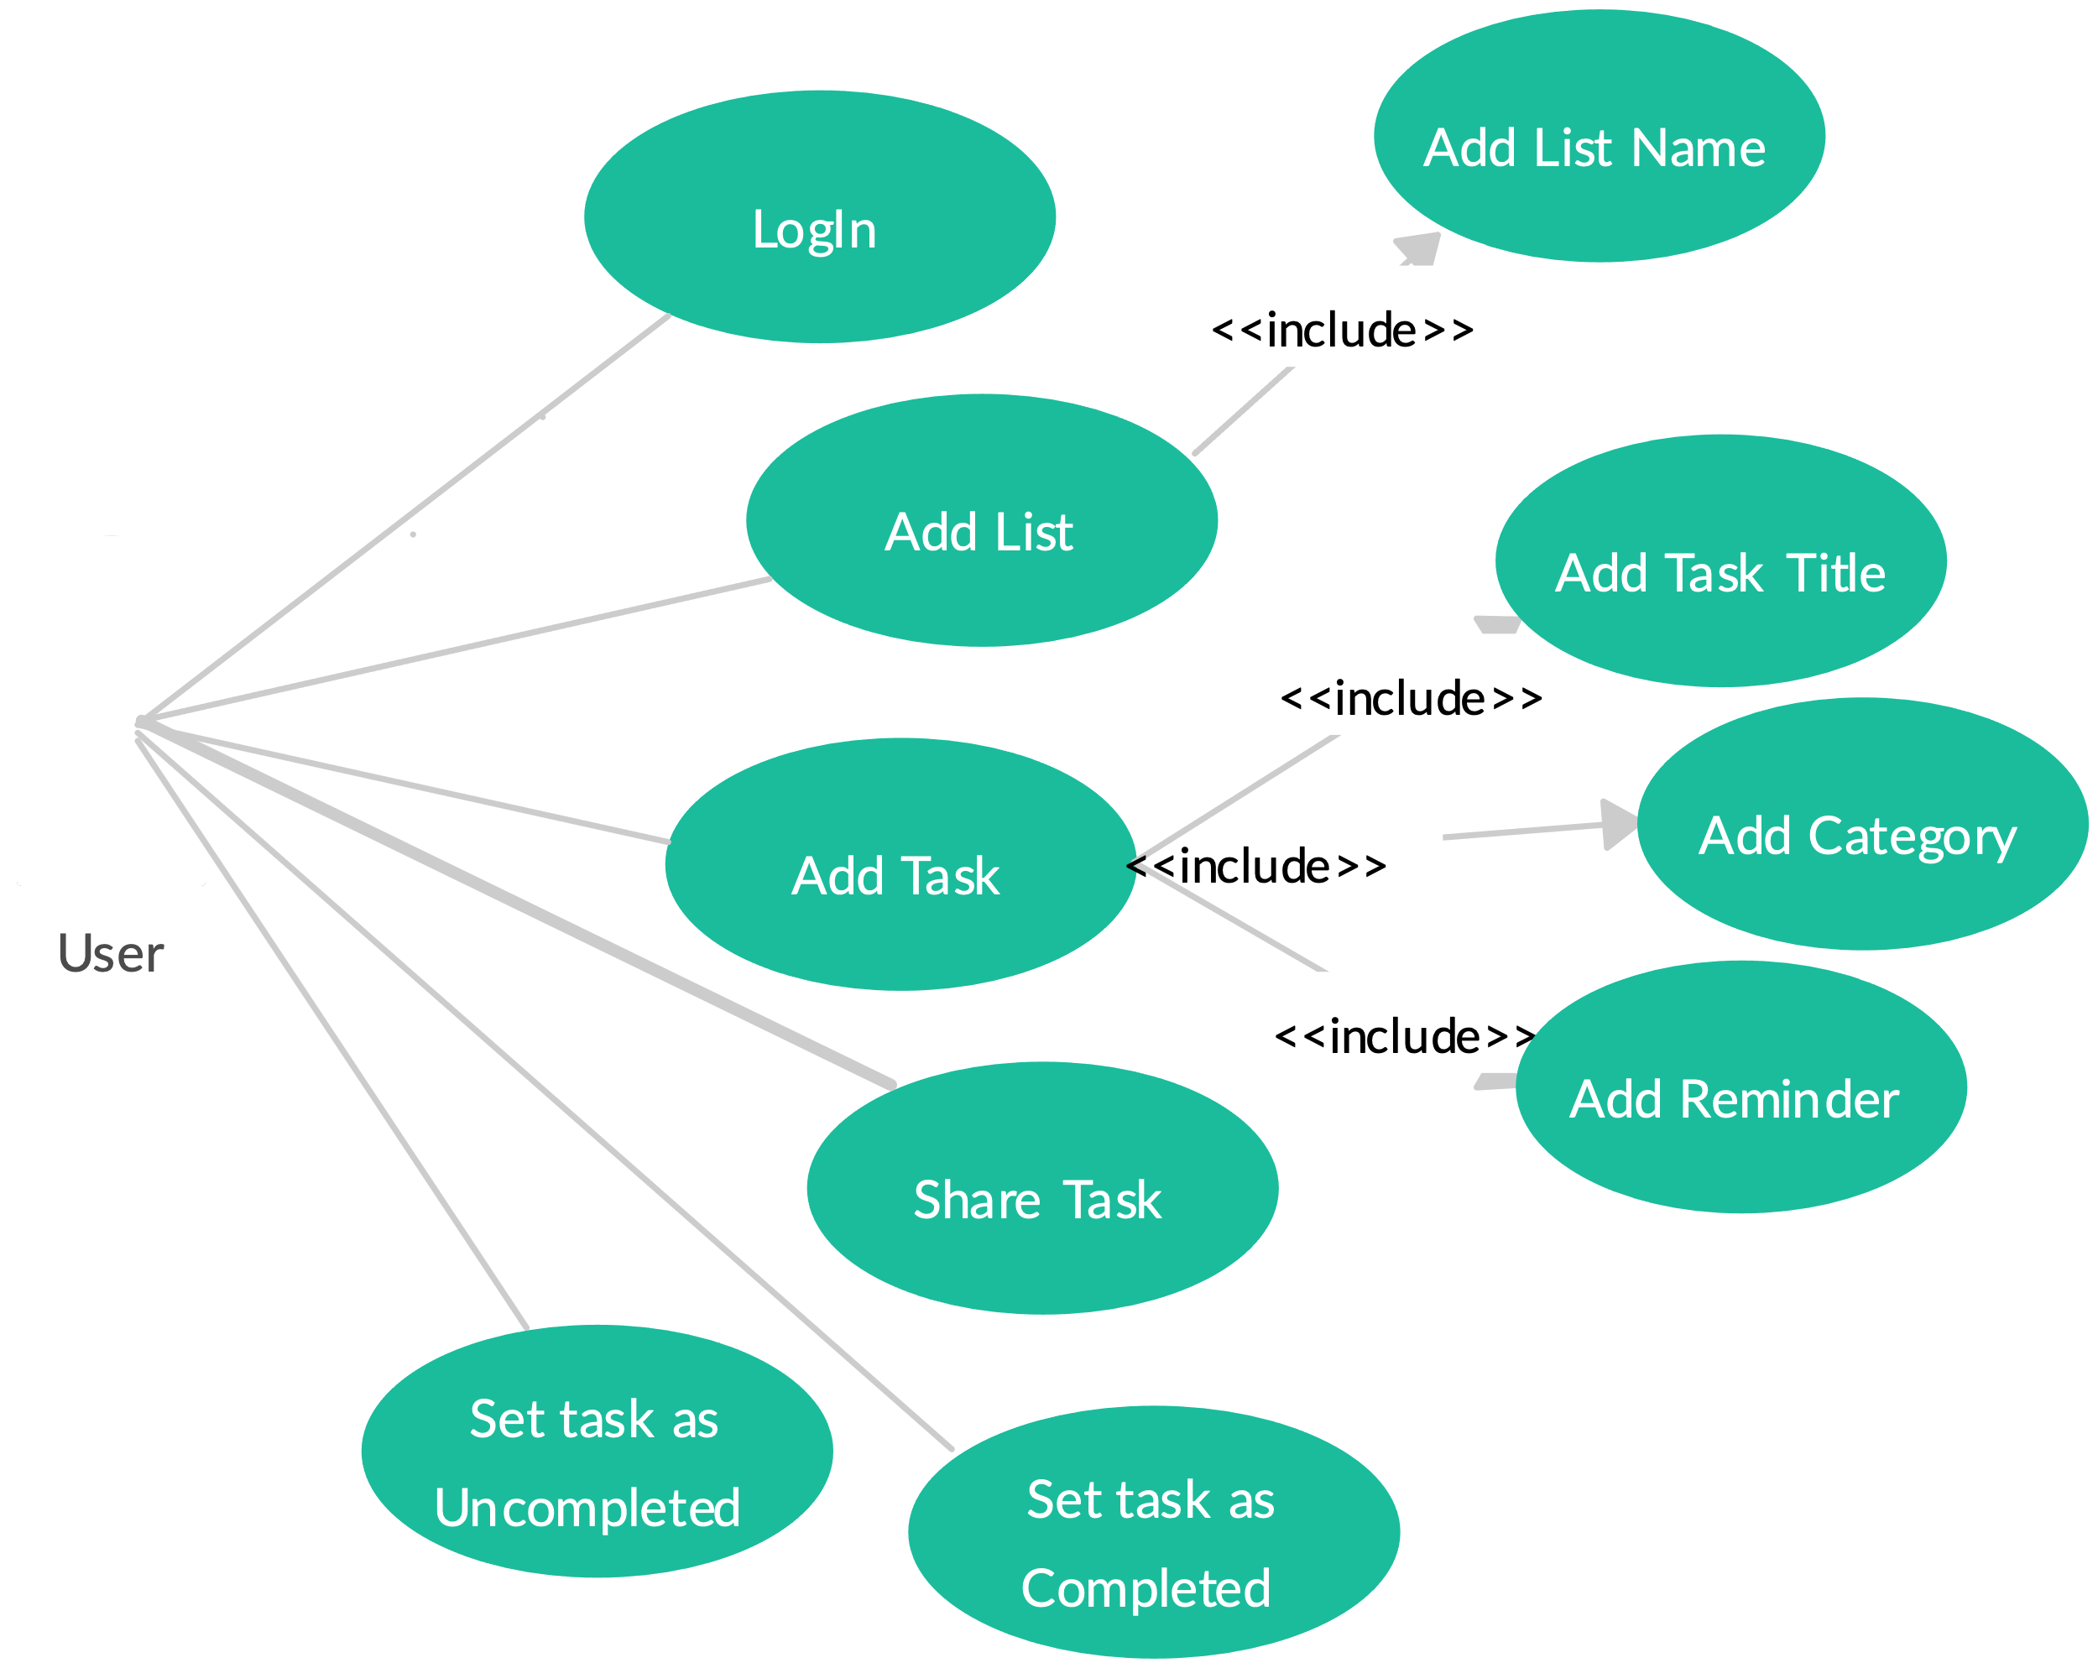
Architecture Diagram

Slide 4
Approach
1. Design and Planning:
Functionality: Define the app's features like adding, editing, and marking tasks as complete.
Data Persistence: Decide how to persist data (locally or cloud-based) for offline access.
UI/UX: Design a user-friendly interface for adding, managing, and visualizing tasks. 2. Setting Up the Project:
Create a new Flutter project.
2. Setting Up the Project:
Create a new Flutter project.
Choose a state management solution: Provider, Bloc, or Flutter Hooks.
Integrate required packages: Hive for local storage, Firebase for cloud storage.
Additional Considerations:
User authentication: Implement if syncing across devices is a feature.
Notifications: Remind users about upcoming tasks.
Customization: Allow users to personalize their app experience.
4. Testing and Deploying:
Thoroughly test the app on various devices and platforms.
Deploy the app to app stores (Google Play Store, Apple App Store).
3. Building the App:
Develop UI components: List view for tasks, input field for adding new tasks, checkboxes for marking complete.
Implement task management: Add, edit, delete, and mark tasks as complete.
Handle data persistence: Save and load tasks using chosen method.

Slide 5
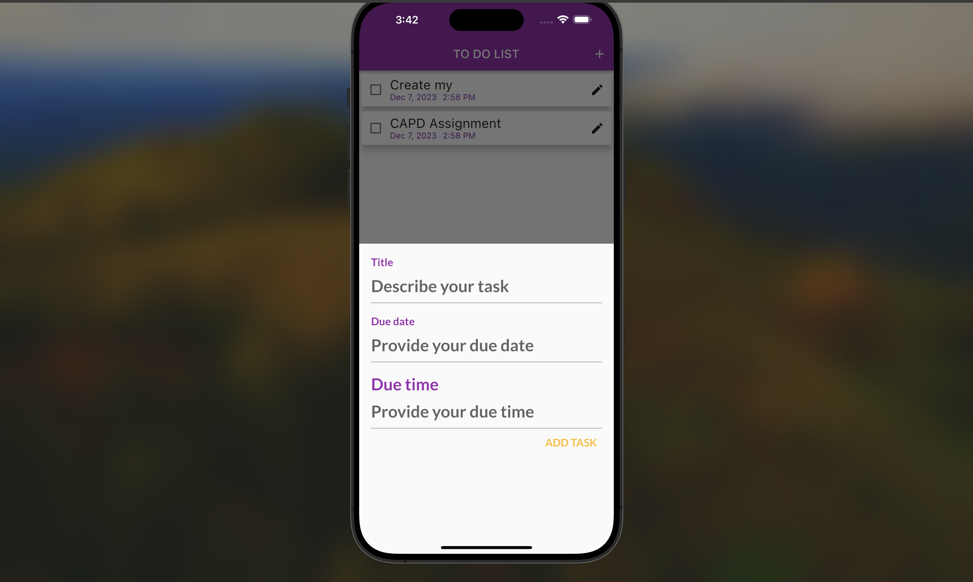

Slide 6


Slide 7
Thank You

